Slide 1
Smart Contracts and Ethereum
Winter School on Cryptocurrency and Blockchain Technologies
Shanghai, Jan. 15-17 2017
Loi Luu
National University of Singapore
Some slides are courtesy of Vitalik Buterin

Slide 2
Agenda
Smart contracts and applications
Ethereum
Interesting Ethereum-based projects
Problems & challenges

Slide 3
Smart contracts

Slide 4
Definition
A smart contract is a computer program executed in a secure environment that directly controls digital assets

Slide 5
A smart contract is a computer program executed in a secure environment that directly controls digital assets

Slide 6
A computer program is a collection of instructions that performs a specific task when executed by a computer. A computer requires programs to function, and typically executes the program's instructions in a central processing unit.
Wikipedia

Slide 7
Example: bet on an event
if HAS_EVENT_X_HAPPENED() is true:
send(party_A, 1000)
else:
send(party_B, 1000)

Slide 8
A smart contract is a computer program executed in a secure environment that directly controls digital assets

Slide 9
Properties of Secure Environments
Correctness of execution
The execution is done correctly, is not tampered
Integrity of code and data
Optional properties
Confidentiality of code and data
Verifiability of execution
Availability for the programs running inside

Slide 10
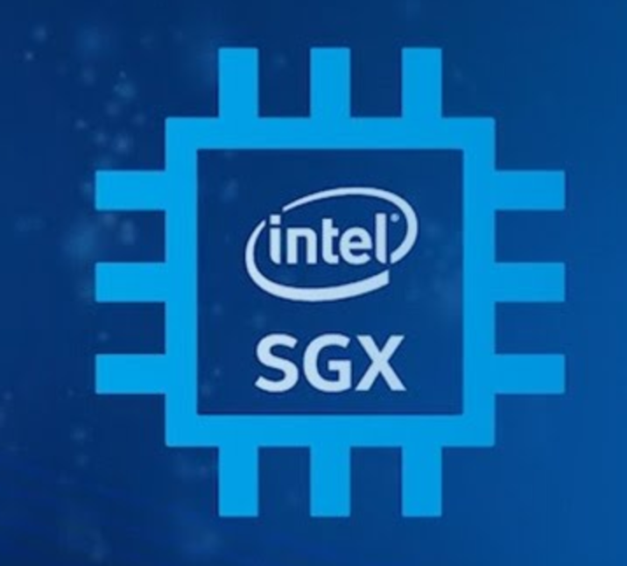
Examples of secure environments
Servers run by trusted parties
Decentralized computer network (ie. blockchains)
Quasi-decentralized computer network (ie. consortium blockchains)
Servers secured by trusted hardware (e.g. SGX)

Slide 11
A smart contract is a computer program executed in a secure environment that directly controls digital assets

Slide 12
Example
Legal contract: “I promise to send you $100 if my lecture is rated 1*”
Smart contract: “I send $100 into a computer program executed in a secure environment which sends $100 to you if the rating of my lecture is 1*, otherwise it eventually sends $100 back to me”

Slide 13
A smart contract is a computer program executed in a secure environment that directly controls digital assets

Slide 14
What are digital assets?
A broad category
Domain name
Website
Money
Anything tokenisable (e.g. gold, silver, stock share etc)
Game items
Network bandwidth, computation cycles

Slide 15
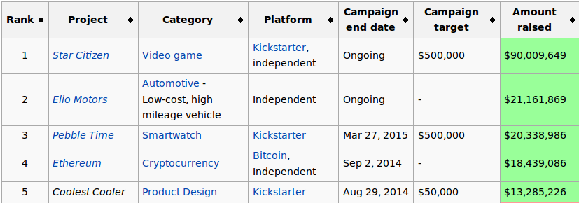
Example: top 5 crowdfunding campaigns in history

Slide 16
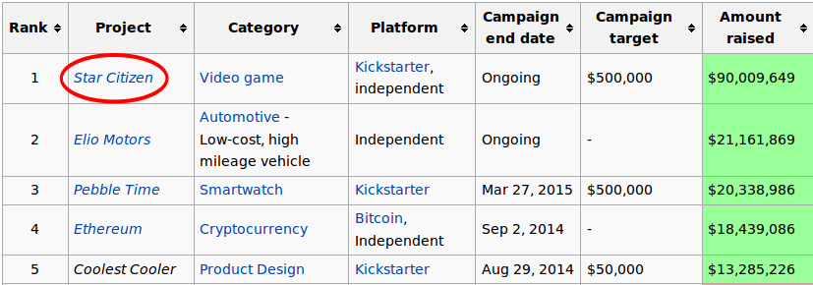
Star Citizen sold virtual spaceships in their game for $500 each

Slide 17
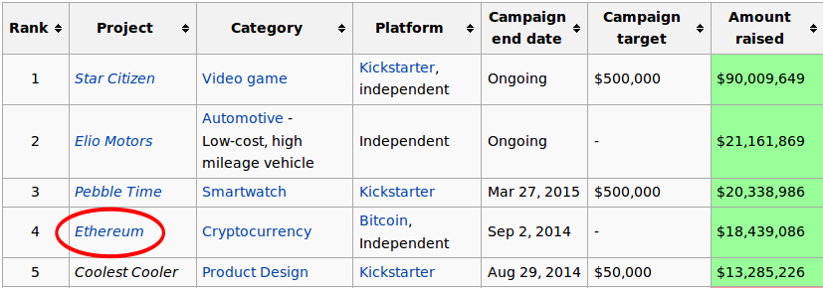
Ethereum Foundation sold 60,102,206 digital tokens which will be useful in a decentralized network

Slide 18
What are smart contracts’ applications?

Slide 19
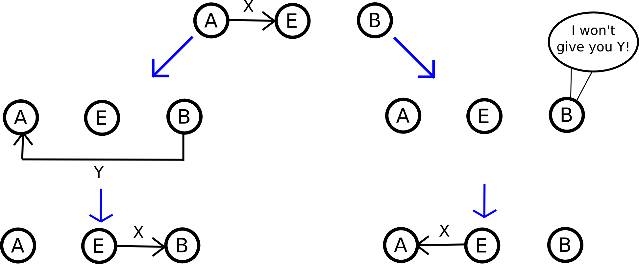
Example: escrow service for exchange

Slide 20
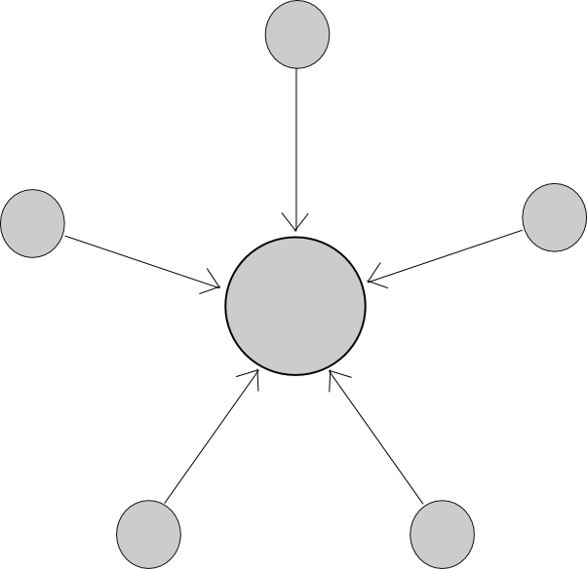
Example: multisig
Require M of N “owners” to agree in order for a particular digital asset to be transferred
Individual use cases
eg. two-factor authentication
Intra-organizational use cases

Slide 21
A lot more interesting applications
Individual/intra-organizational
Complex access policies depending on amount, withdrawal limits, etc
Dead man’s switch, “digital will”
E.g When the owner dies, transfer all assets to someone
General
Prediction markets
Insurance
Micro-payments for computational services (file storage, bandwidth, computation, etc)

Slide 22
Why smart contracts?
Automated processing
Trust reduction
Trust the secure environments, not a very large number of contract enforcement mechanisms
Unambiguous, terms clearly expressed in code
Question: how to express terms clearly in code?

Slide 23
Smart contracts vs legal contracts
A smart contract is more like a vending machine
Follow predetermined rules
Legal contracts | Smart contracts
Good at subjective (ie. requiring human judgement) claims | Good at objective (ie. mathematically evaluable) claims
High cost | Low cost
May require long legal process | Fast and automated
Relies on penalties | Relies on collateral/security deposits
Jurisdiction-bound | Potentially international (“a-legal”)

Slide 24
Smart contracts vs legal contracts
Example: smart contracts are not very effective for loans
Has the capital to provide liquid collateral for a loan, do not need the loan in the first place
Can use illiquid collateral though (eg. domain names)
Example: legal contracts are not very effective for the anti-spam use case
amounts at stake are so small
spammers can locate themselves in favorable jurisdictions and evade detection

Slide 25
Ethereum: the first blockchain-based smart contract platform

Slide 26
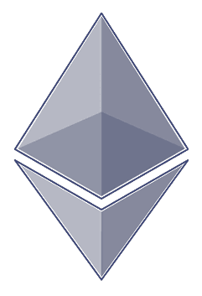
Ethereum
Blockchain with expressive programming language
Programming language makes it ideal for smart contracts
Why?
Most public blockchains are cryptocurrencies
Can only transfer coins between users
Smart contracts enable much more applications
Notes:
Asset issuance, crowdfunding, domain registration, title registration, gambling, prediction markets, internet of things, voting, hundreds of applications!

Slide 27
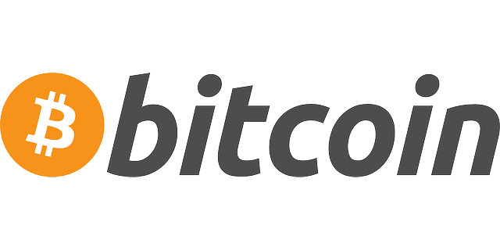
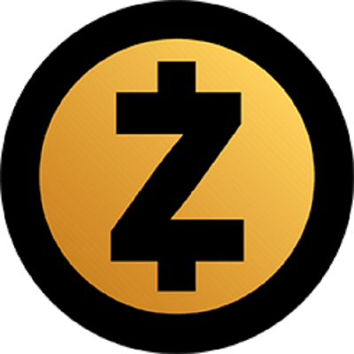
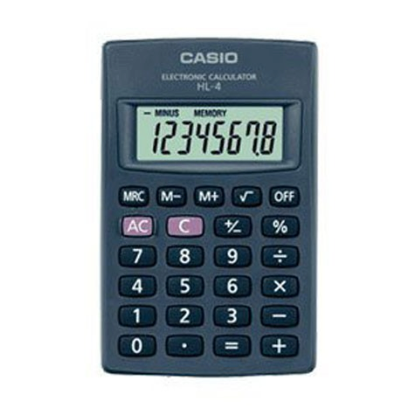

Analogy: Most existing blockchain protocols were designed like
**********
OR THIS

Slide 28

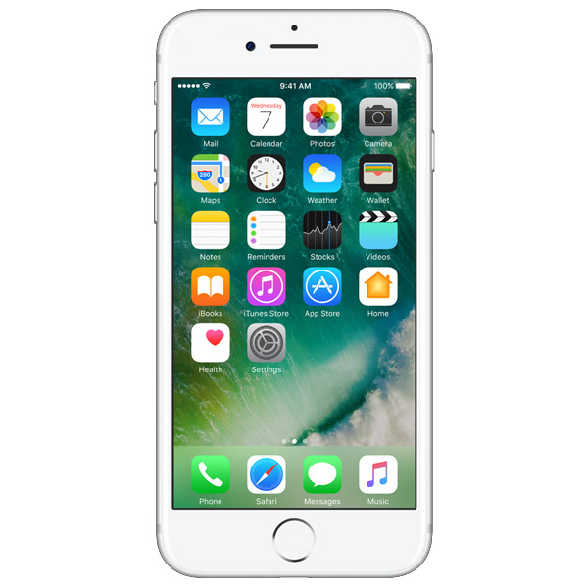
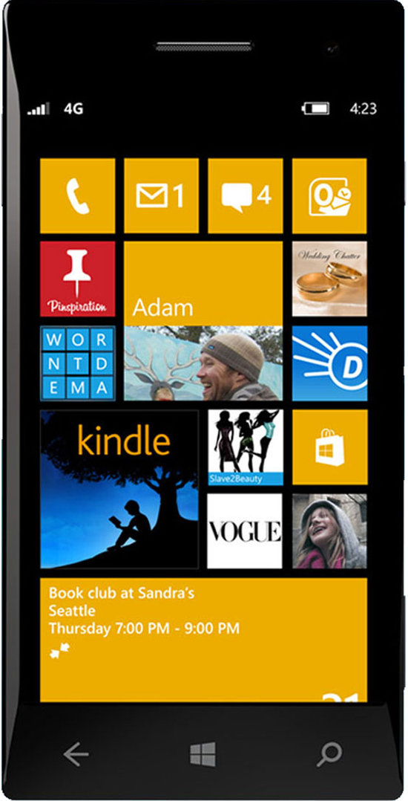
why not make a protocol that works like
OR THIS
OR THIS

Slide 29
How Ethereum Works
Two types of account:
Normal account like in Bitcoin
has balance and address
Smart Contract account
like an object: containing (i) code, and (ii) private storage (key-value storage)
Code can
Send ETH to other accounts
Read/write storage
Call (ie. start execution in) other contracts

Slide 30
DNS: The “Hello World” of Ethereum
data domains[](owner, ip)
def register(addr):
if not self.domains[addr].owner:
self.domains[addr].owner = msg.sender
def set_ip(addr, ip):
if self.domains[addr].owner == msg.sender:
self.domains[addr].ip = ip
Private Storage
Can be invoked by other accounts

Slide 31
Ethereum Languages
Types, invariants, looks like Javascript
Looks like python
Serpent
Solidity
Functional, macros,
looks like scheme
Lower-Level Language
Looks like Forth.
Defined in Yellowpaper
Ethereum VM Bytecode
Stack Language
Slide is courtesy of Andrew Miller

Slide 32
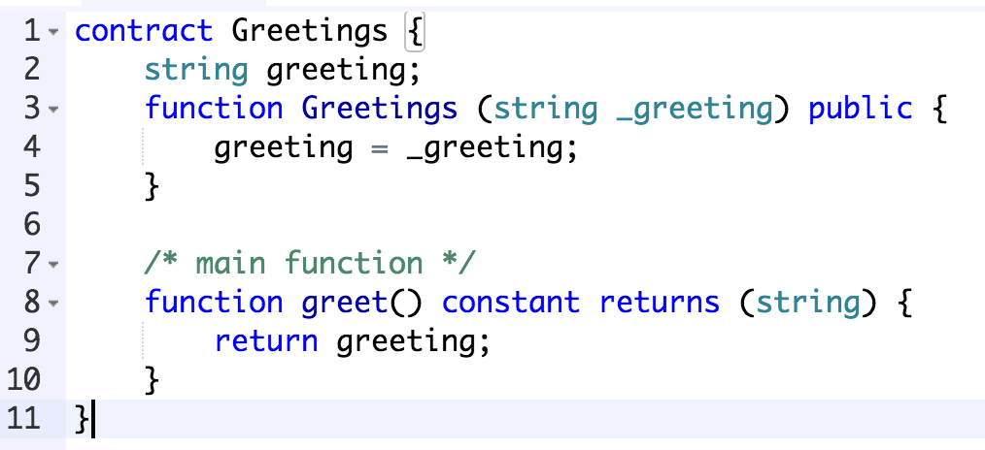
Example
What other see on the blockchain
6060604052604051610250380380610250833981016040528........
PUSH 60
PUSH 40
MSTORE
PUSH 0
CALLDATALOAD
.....
What you write
What people get from the disassembler

Slide 33
Transactions in Ethereum
Normal transactions like Bitcoin transactions
Send tokens between accounts
Transactions to contracts
like function calls to objects
specify which object you are talking to, which function, and what data (if possible)
Transactions to create contracts

Slide 34
Transactions
nonce (anti-replay-attack)
to (destination address)
value (amount of ETH to send)
data (readable by contract code)
gasprice (amount of ether per unit gas)
startgas (maximum gas consumable)
v, r, s (ECDSA signature values)

Slide 35
How to Create a Contract?
Submit a transaction to the blockchain
nonce: previous nonce + 1
to: empty
value: value sent to the new contract
data: contains the code of the contract
gasprice (amount of ether per unit gas)
startgas (maximum gas consumable)
v, r, s (ECDSA signature values)
If tx is successful
Returns the address of the new contract

Slide 36
How to Interact With a Contract?
Submit a transaction to the blockchain
nonce: previous nonce + 1
to: contract address
value: value sent to the new contract
data: data supposed to be read by the contract
gasprice (amount of ether per unit gas)
startgas (maximum gas consumable)
v, r, s (ECDSA signature values)
If tx is successful
Returns outputs from the contract (if applicable)

Slide 37
Blockchain State
Bitcoin’s state consists of key value mapping addresses to account balance
Ethereum’s state consists of key value mapping addresses to account objects
Address | Balance (BTC)
0x123456… | 10
0x1a2b3f… | 1
0xab123d… | 1.1
Address | Object
0x123456… | X
0x1a2b3f… | Y
0xab123d… | Z
Blockchain != Blockchain State

Slide 38
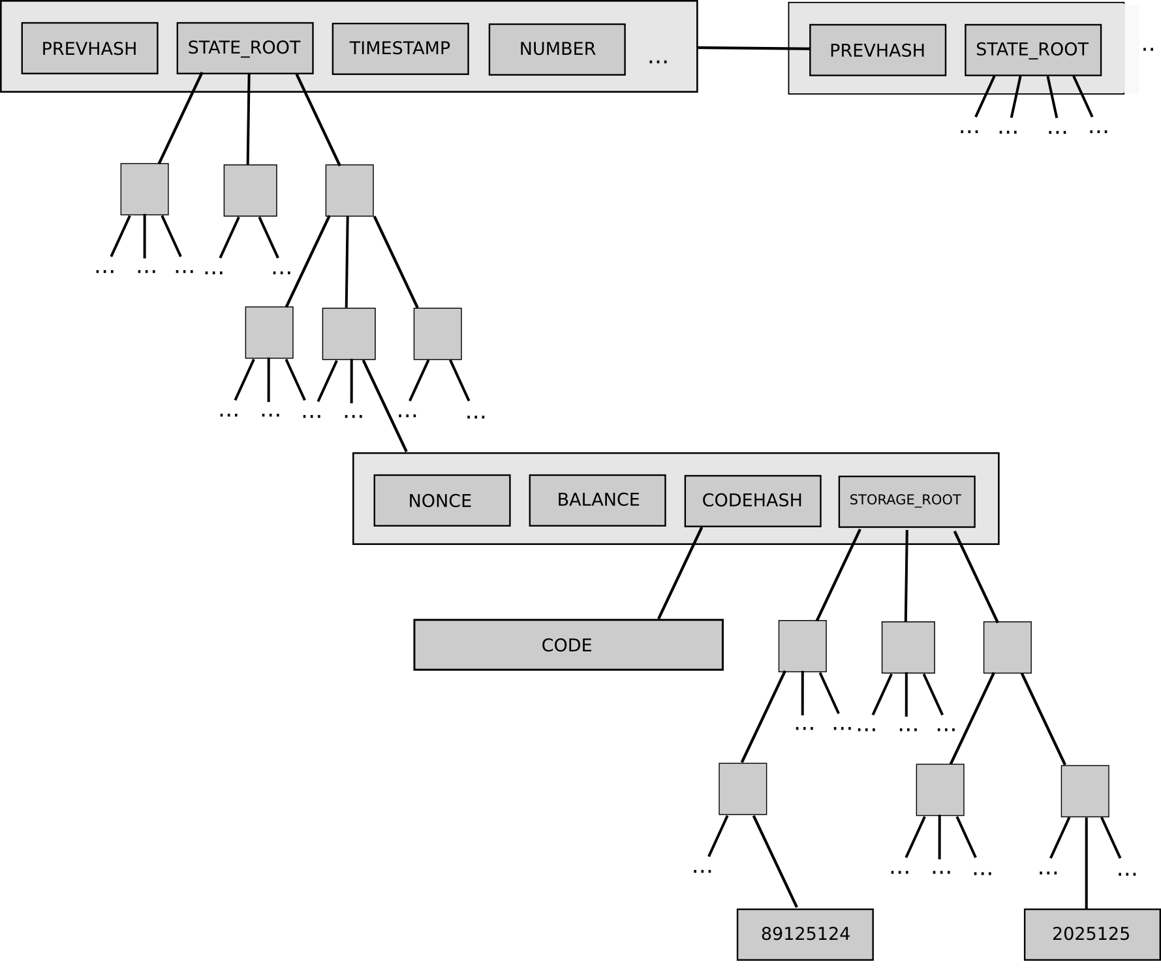
Account Object
Every account object contains 4 pieces of data:
Nonce
Balance
Code hash (code = empty string for normal accounts)
Storage trie root

Slide 39
Block Mining
Block
A set of TXs
Previous block
New State Root
Receipt Root
Nonce
Tx-1
Tx-n
Verify transactions & execute all code to update the state
Tx-2
SHA3(Block) < D
Broadcast Block
Miners

Slide 40
Code execution
Every (full) node on the blockchain processes every transaction and stores the entire state
P1
This is a new block!
This is a new block!
P6
P2
This is a new block!
This is a new block!
P5
P3
I’m a leader
This is a new block!
P4
This is a new block!

Slide 41
Dos Attack Vector
Halting problem
Cannot tell whether or not a program will run infinitely
A malicious miner can DoS attack full nodes by including lots of computation in their txs
Full nodes attacked when verifying the block
uint i = 1;
while (i++ > 0) {
donothing();
}

Slide 42
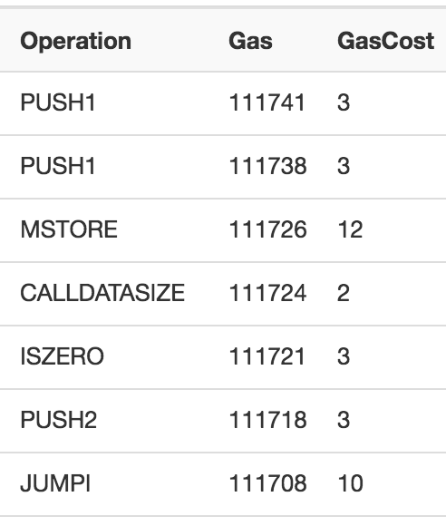
Solution: Gas
Charge fee per computational step (“gas”)
Special gas fees for operations that take up storage

Slide 43
Sender has to pay for the gas
gasprice: amount of ether per unit gas
startgas: maximum gas consumable
If startgas is less than needed
Out of gas exception, revert the state as if the TX has never happened
Sender still pays all the gas
TX fee = gasprice * consumedgas
Gas limit: similar to block size limit in Bitcoin
Total gas spent by all transactions in a block < Gas Limit

Slide 44
Interesting Ethereum-based projects

Slide 45
BTCRelay
A bridge between the Bitcoin blockchain & the Ethereum blockchain
Allow to verify Bitcoin transactions within Ethereum network
Allow Ethereum contracts to read information from Bitcoin blockchain
Bitcoin Network
BTCRelay
Ethereum Network

Slide 46
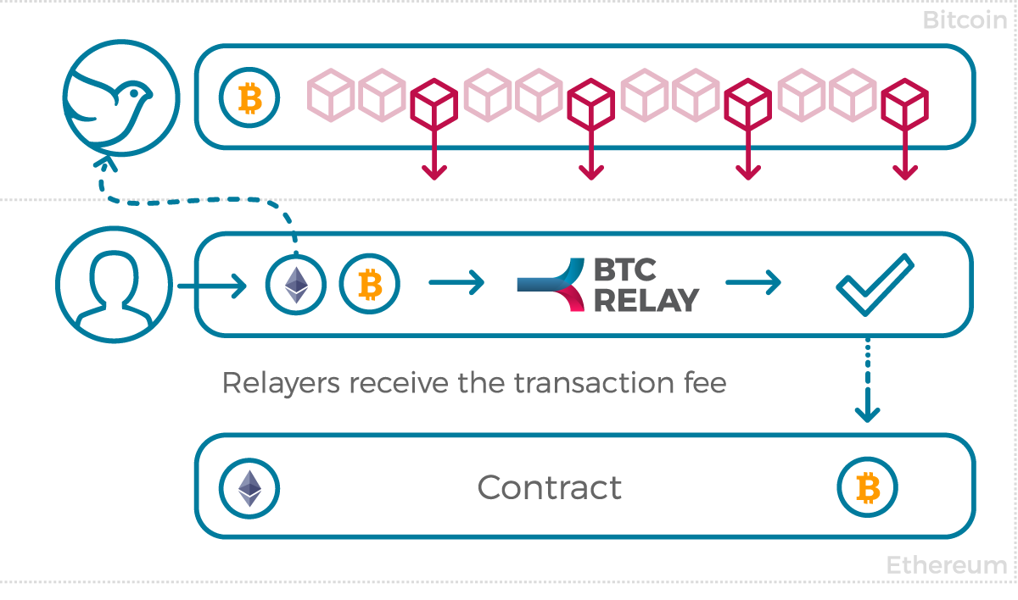
BTCRelay – How it works
Bitcoin
Relayers constantly submit Bitcoin block headers
A Bitcoin transaction is submitted, BTCRelay verifies TX based on the block header
The verified Bitcoin transaction is relayed to the smart contract
Ethereum

Slide 47



BTCRelay Application: ETH-BTC atomic swaps
50 ETH for anyone who sends 1 BTC to my address
ETH-BTC Swap contract
I sent 1 Bitcoin to Alice address, here is the proof P
Check proof P
Send 50 ETH
BTCRelay
Send 1 BTC to Alice address
Bitcoin Network

Slide 48
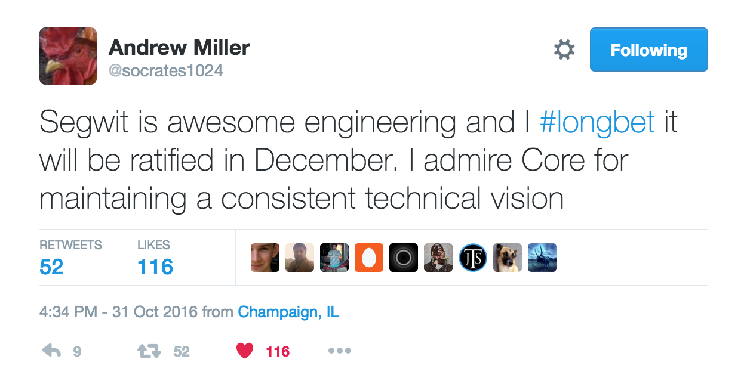
BTCRelay Application: Contracts can read information of Bitcoin blockchain
E.g. betting on the outcomes of events on Bitcoin blockchain

Slide 49
Other Work-in-progress Relays
Project Alchemy
Zcash relay
Dogecoin/ Litecoin Relay
Dogecoin light client on Ethereum by Vitalik
Interactive verification for Scrypt pow by Christian
Question: can we build a decentralized exchange between cryptocurrencies using all the relays?

Slide 50
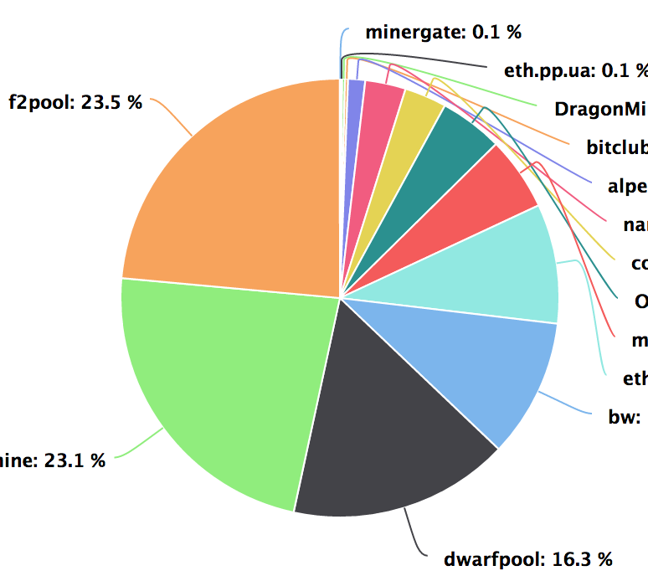
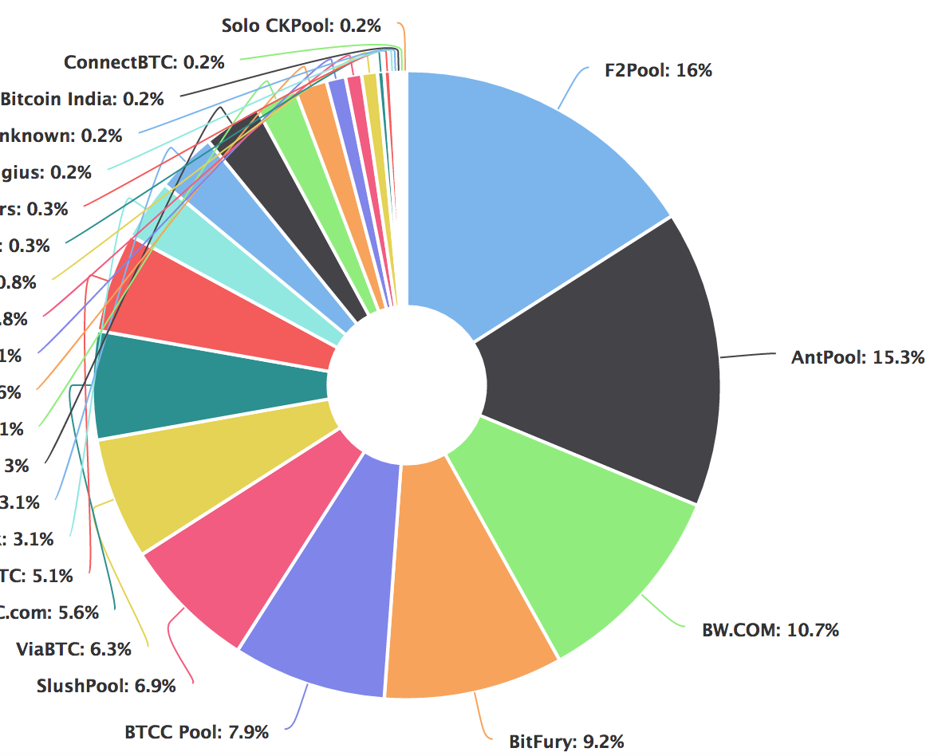
SmartPool
Decentralized Mining Pools using Smart Contracts
Problem: mining centralization
Miners go to mining pools for stable and frequent rewards
Decentralized platforms are secured by centralized entities
Transaction censorships
Single point of failures

Slide 51


Pooled mining
Pools track miners’ contribution by using shares
A share is similar to a block, but required less work to find
Bitcoin Network
Block
Block
Block
Pool operator
Shares

Slide 52
P2Pool: decentralized mining pool
Miners maintain the pool’s contributions by themselves
Maintain a share-chain within the pool (just like the blockchain)
Pay miners in proportional to their contributions
Done in the coinbase transaction
When a miner finds a share
Broadcast to all miners
Check if the coinbase tx is correct and extend the share-chain
Bitcoin Network
Block
P2Pool
Shares

Slide 53
Why P2Pool is Inefficient and not scalable?
Millions of messages per block (each per share)
Expensive to everyone
Reducing the number of shares?
No, will increase the variance of reward
Bitcoin Network
Block
P2Pool
Shares

Slide 54
SmartPool: Efficient P2Pool using SmartContract
Track miners’ contributions to the pool in a contract
Allows batch submissions, e.g. billions of shares in a claim
Reduce number of messages (txs) to the contract significantly
Use probabilistic verification to check a submission
Randomly verify only one share per submission
Probability of cheating being detected is proportional to the amount of cheating
SmartPool
Sample &Check
Submit

Slide 55
SmartPool: Disincentivize cheating
Payment scheme: pay 0 for a submission if cheating detected
Expected reward is the same whether cheating or not
Miners have no incentive to cheat
Reward = 1
passed
Get 1.5 Reward with 2/3 probability
Probabilistic verification
Expected reward = 1
Get 0 Reward with 1/3 probability
detected

Slide 56
More in the paper
How to prevent miners from stealing others’ shares?
How to prevent claiming a share multiple times
Within a submission
Across submissions
How to verify Ethash PoW?
Require huge memory and storage

Slide 57
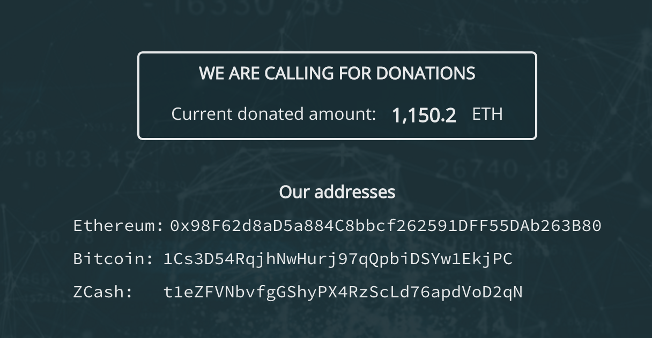
SmartPool.io is calling for donation

Slide 58
A lot more interesting apps
TownCrier and Oraclize
allow contracts to fetch external data from real websites
Enable a lots of applications: betting, insurance, bounty based on real world event
Augur and Gnosis
Prediction market: predict the outcome of real world event to get reward
Many others: theDao, iConomi, Golem, etc

Slide 59
Problems/ challenges

Slide 60
Privacy
Ethereum blockchain guarantees correctness and availability, not privacy for smart contracts
Everything on the Ethereum blockchain is public
Cannot execute on private data (e.g. death will remains secret until the owner dies)
Transactions are traceable
Analysing transaction graph [IMC’13]

Slide 61
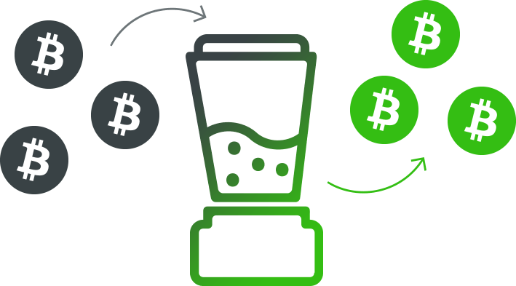
Privacy Solution
Hawk (Kosba et al. IEEE S&P’16)
Privacy-Preserving Smart Contracts
Execute confidential, fair, multiparty protocols
ZeroCash over Ethereum, Ring signatures on Ethereum
Mixing coins with others
E
E
E
E
E
E

Slide 62
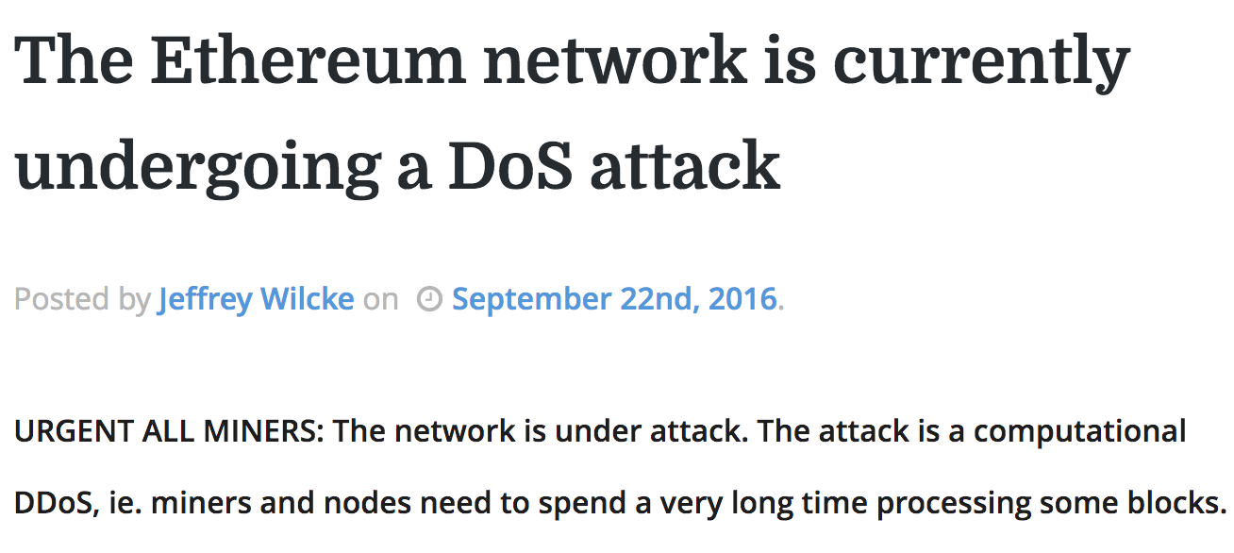
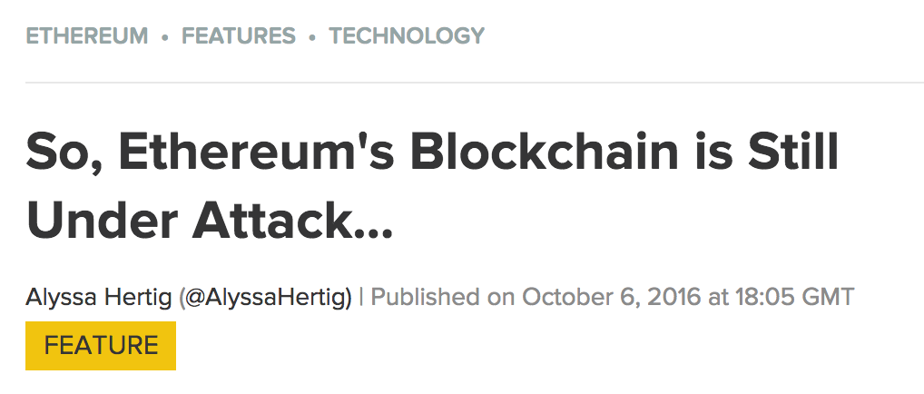


Scalability
Resources on blockchain are expensive
Full nodes perform the same on-chain computations
Full nodes store the same data
Gas-limit is relatively small
Can’t run an OS on blockchain
Can’t increase gas-limit: DoS vector

Slide 63
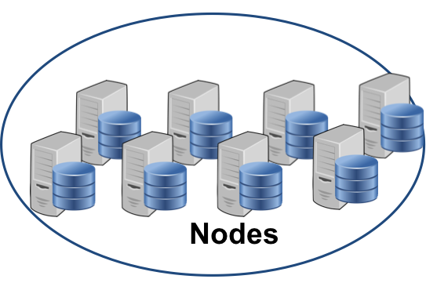
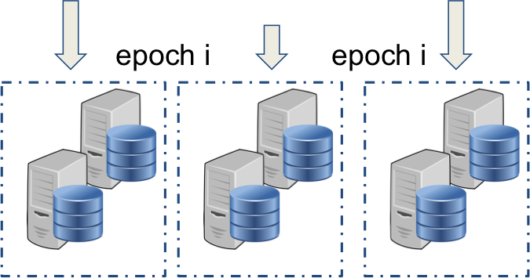
Scalability Solution 1: Sharding
Divide the network into sub-networks
each stores and manages a fraction of the blockchain (a shard)
Allow scaling up as the network grows
There is a catch
May affect usability or performance
May not be compatible with all existing applications
Shard 1
Shard 2
Shard 3

Slide 64
Scalability Solution 2: State Channel
Similar to payment channel (e.g. lightning network) but for states
Scaling by using off-chain transactions
Can update the state multiple times
Only settlement transactions are on-chain
Challenges
Cannot create state channel for all applications
Still early research, more work needed
Blockchain
Alice
Bob
TX1
TX2
Contract X
X’s Initial State
Many states i
TX3
X’s Final State
TX4

Slide 65
Scalability Solutions: Other approaches
Storage rental
Problem: data fee is charged once
Idea: Charge more fees if store data longer
Similar to resource tax
Incentivize users to remove unnecessary data
Hardware-rooted trust
Using SGX to build state channel?
(Inspired by teechan protocol)

Slide 66
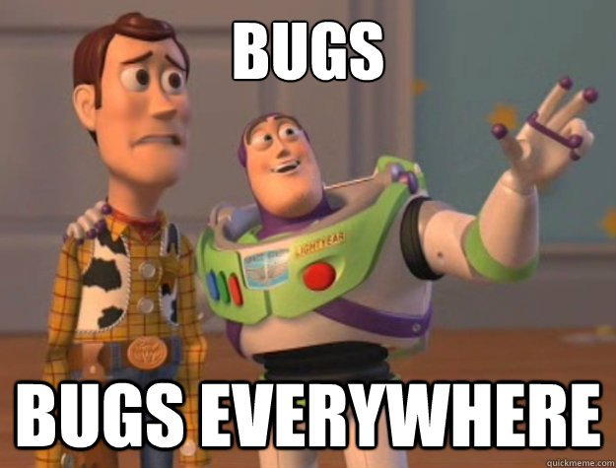
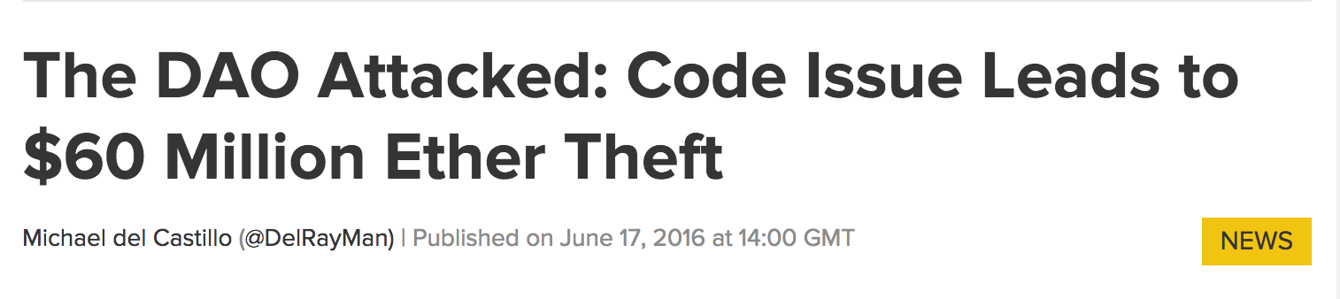
Security Flaws
Due to abstraction of semantic
Transaction ordering dependence
Reentrancy bug
Which exploited the DAO
Obscure VM rules
Maximum stack depth is 1024: not many devs know
Inconsistent Exception Handling in EVM

Slide 67
Example 1: Transaction Ordering Dependence
PuzzleSolver Contract
Balance: 100
PuzzleSolver()
SetPuzzle
reward=100
Anyone can submit a solution to claim the reward
SubmitSolution(solution)
if isCorrect(solution):
Send(reward)
Owner can update the reward anytime
UpdateReward(newReward) reward=newReward

Slide 68

Scenario 1: SubmitSolution is trigerred
+100
PuzzleSolver Contract
Balance: 100
Balance: 0
PuzzleSolver()
SetDifficulty
reward=100
Random TXs
Solution for Puzzle
Block
Random TXs
SubmitSolution
Other TXs
Other TXs
SubmitSolution(solution)
if isCorrect(solution):
Send(reward)
Miners
UpdateReward(newReward) reward=newReward

Slide 69

Scenario 2: Both SubmitSolution and UpdateReward are triggered
+0
PuzzleSolver Contract
Balance: 0
Balance:100
PuzzleSolver()
SetDifficulty
reward=100
Update Reward to $0!
Solution for Puzzle
Block
UpdateReward = 0
SubmitSolution
Other TXs
Other TXs
SubmitSolution(solution)
if isCorrect(solution):
Send(reward)
Miners
UpdateReward(newReward) reward=newReward

Slide 70
Transaction Ordering Dependence
Observed state != execution state
Transactions do not have atomicity property
Can be coincidence
Two transactions happen at the same time
Update Reward to $0!
Solution for Puzzle
Other TXs

Slide 71
Transaction Ordering Dependence
Observed state != execution state
Transactions do not have atomicity property
Can be coincidence
Two transactions happen at the same time
Can be a malicious intention
Saw the targeted TX from the victim
Submit the second TX to update the reward
Both TXs enter the race
Update Reward to $0!
Solution for Puzzle
Other TXs

Slide 72
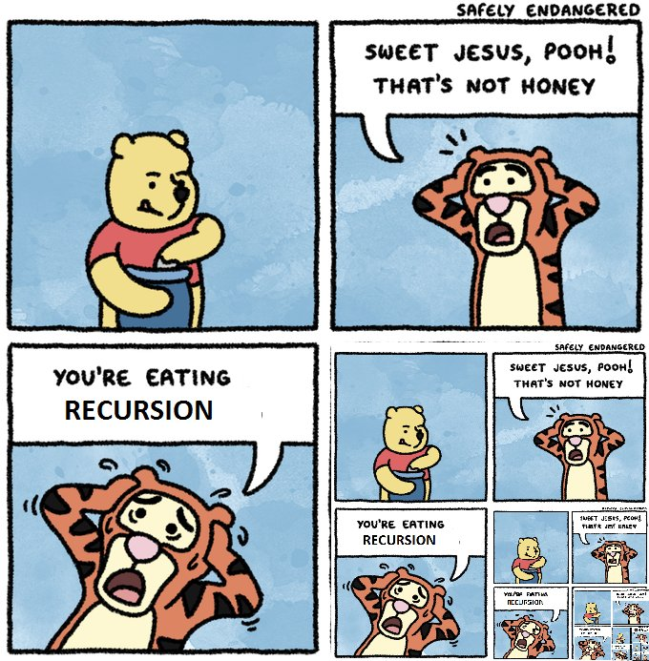
Example 2: Reentrancy Bug --- TheDAO Bug
Reentrancy vulnerability
Most expensive vulnerability to date
Call before balance update
...
// Burn DAO Tokens
if (balances[msg.sender] == 0)
throw;
withdrawRewardFor(msg.sender);
totalSupply -= balances[msg.sender];
balances[msg.sender] = 0;
paidOut[msg.sender] = 0;
return true;
Notes:
Finally, let us consider the vulnerability popularized by TheDAO contract we briefly covered at the beginning. This has been the single largest instance of a smart contract bug - in terms of monetary loss - with the amount lost from TheDAO being larger than all the discovered possible losses of all the other bugs combined.
Let us see how it works. Consider the snippet of code we saw earlier. This particular piece of code is quite self-explanatory. A transfer event is registered to the blockchain, after which a reward is withdrawn and the contracts internal balances are updated. However, the issue is in the payOut function, which is called by withdrawReward, and we will analyse this in detail.
The recipient contract is called with the Ether value which is at the root of this vulnerability. When a call is made, the recipient contract is executed, and control does not return to the calling contract until is it complete.
Now let's consider what happens here. When a call is made, the contract sends the payment to a receiving contract along with it's remaining fuel for computation which the receiving contract can use to perform some function. After this, control returns to the calling contract, and the balances are updated. However, if the contract were malicious, it could reenter the caller to re-execute the original call and double the payout - this will be valid since the balances have not been updated yet. In fact, this can repeated as many times as needed until the call is exhausted.
This occurs partly because the developer is often unaware of the distinction between a function call and a contract call, as well as the difference between a SEND and a CALL. Intending to send a payment to another contract, he is unaware that the receiving contract may begin executing code that can take advantage of the intermediate state of the calling contract.
This is the attack that crippled theDAO and enabled the attacker to siphon millions out of the contract. It tells us that large decentralised contracts such as theDAO are even more vulnerable to the semantic gaps and lack of understanding, further emphasizing the need for an automated pre-deployment testing.

Slide 73
TheDAO Bug: Honest Secenario
TheDao
Balance: 100
Payout : 100
Balance: 100
Payout : 0
Balance: 0
Payout : 100
splitDAO(proposal, address)
withdrawRewardFor(msg.sender)
Receiver
rewardAccount.payOut(_account, reward)
function() {}
balances[msg.sender] = 0;

Slide 74
TheDAO Bug: Attack Scenario
TheDao
Balance: 100
Payout : 300
Balance: 100
Payout : 500
Balance: 100
Payout : 200
Balance: 100
Payout : 100
Balance: 100
Payout : 0
Balance: 100
Payout : 400
splitDAO(proposal, address)
withdrawRewardFor(msg.sender)
Receiver
rewardAccount.payOut(_account, reward)
splitDAO()

Slide 75
Solutions to Resolve Security Flaws
Create developer tools
Smart contract analyser based on symbolic exec: Oyente
Testing and deployment framework: truffle
Formal verification for smart contracts: eth-isabelle, why3
Design better semantic [CCS’16]
Educate users
Idea
Create security certificates for smart contracts?

Slide 76
Closing thought
Ethereum and Smart contract are awesome, build your own Dapp today!
Pay more attention to security

Slide 77
Oyente: An Analyzer for Smart Contracts

Slide 78
Architecture
Based on symbolic execution
Have separate modules
Can add more analysis separately
6060604052123123123528.....
ByteCode
CFG BUILDER
Visualizer
Ethereum
State
EXPLORER
CORE ANALYSIS
VALIDATOR
Z3 Bit-Vector Solver

Slide 79
Symbolic Execution
Inputs
Is there any value of x?
T
F
T
T
F
T
F
T
T
Symbolic
Formula
F
T
F
Theorem Prover
NO
YES
Control
Flow Graph
Execution Trace

Slide 80
What Can Oyente Do?
Detect Bugs In Existing Smart Contracts
Run with 19, 366 contracts
30 mins timeout per contract
Test generation
Cover all possible paths of each program
T
F
T
F
F
T
F
T

Slide 81
Oyente is Open Source
https://github.com/ethereum/oyente
Future work
Support more opcodes
Handle loops
Combine static and dynamic symbolic executions

